Slide 1

Medical Advisory Panel (MAP) Meeting
TA CRM Update
To insert a wordmark:
Add (e.g. via drag and drop) your wordmark file (in RGB) to this slide (in alignment with our brand governance and architecture guidelines)
Change the size of the wordmark according to the height reference (magenta placeholder)
Select the “guides” in the navigation bar and move the wordmark to the right and top line (orange)
  15-May-2025

Slide 2
Topics
Pipeline Key Update
Decisions/Advice Provided by TA-CEC
TA Portfolio Key Update-Late Stage Assets
China Local Data Generation Key Update
TA Portfolio Key Update-Early Assets

Slide 3




Milestones in 2025
Obesity
Liver disease
CKD
Cardiovascular disease
Study start/ read-out
Termination
Milestone
Global milestones
RoFD
vica+empa
CVRR
PoCP achieved
Asset discontinuation
endorsed
postponed from Apr
PoCP
BI 3006337
FGF21/GLP-1
MASH cF4
PoCP
BI 764198
TRPC6i
FSGS
RoFD
Avenciguat
GN
RoFD
BI 764198
TRPC6i
FSGS
PoCP
BI 765845
MYDGF
STEMI
PoCP
BI 3034701
GGY2R
obesity
endorsed
Jan 2025
Feb 2025
Mar 2025
Apr 2025
May 2025
Jun 2025
Jul 2025
Aug 2025
Sep 2025
Oct 2025
Nov 2025
Dec 2025
EoPh II sub.
avenciguat
GN
1366-0015
CTA sub.
vica+empa
HFrEF
EASi-HF Reduced
EoPh II sub.
BI 764198
TRPC6i
FSGS
1434-0017
BLA app.
metalye
AIS
Pre-IND sub.
BI 764198
TRPC6i
podocytopathies
1434-0027
CTA sub.
metalyse
AIS > 4.5hr
TENACITY
CTA sub.
avenciguat
GN
1366-0015
fSIV
vica+empa
CKD
(simultaneous, PhII)
1378-0023
CTA sub.
BI 764198
TRPC6i
FSGS
1434-0017
CTA sub.
BI 764198
TRPC6i
Podocytopathies
1434-0027
√
√
√
advanced from Nov
Pre-IND sub.
metalyse
AIS > 4.5hr
TENACITY
CTA sub.
vica+empa
CKD (PhII)
1378-0023
CTA sub.
vica+empa
CVRR
1378-0041
fSIV
vica+empa
CKD
EASi-KIDNEY
postponed from Apr
fSIV
vica+empa
EASi-HF Reduced
√
√
China milestones
Pre-IND sub.
BI 3034701
GGY2R ago.
Obesity
1507-0002
Acronyms
RoFD: release of full development
fSIV: first site initiation visit
CTA sub.: CTA submission
BLA app.: BLA approval
LSR: last subject randomization
BTD: breakthrough therapy designation
STEMI: ST-Elevation Myocardial Infarction
MASH: Metabolic-Associated SteatoHepatitis
CSPH: Clinical Significant Portal Hypertenion
CKD: Chronic Kidney Disease
GN: Glomerulonephritis
FSGS: Focal Segmental Glomerulosclerosis
HFpEF: Heart Failure with Preserved Ejection Fraction
HFrEF: Heart Failure with Reduced Ejection Fraction
AIS: Acute Ischaemic Stroke

Slide 4

CRM Pipeline Portfolio Summary
obesity
liver disease
TA Priority
OneHP Priority
CKD
CVD
BI Number/INN | MOA | Indication | Next Milestone | Timeline | China NDA Appr. Timeline (Best*) | Global status | China Status
Survodutide | GLP1R/GCGR agonist | Obesity | RoS | TBD | 2028-Mar | Ph III ongoing | Ph III ongoing
 |  | MASH | RoS | TBD | 2028-Nov | Ph III ongoing | Ph III ongoing
VicaEmpa | ASi + SGLT2i | CKD | RoS | TBD | 2029-Jan | Ph III ongoing | Ph III ongoing
 |  | HFpEF | RoS | TBD | 2029-May | Ph III ongoing | Ph III ongoing
 |  | HFrEF | RoS | TBD | 2030-Jun | Ph III ongoing | Ph III ongoing
 |  | CVRR | RoS | TBD | 2031-Feb | Ph III ongoing | Ph III ongoing
BI 764198 | TRPC6 Inhibitor | FSGS | RoFD | 2025-Sep | 2030-Oct | To start Ph III (2025-Dec) | To join Ph III
 |  | DMD | RoFD | 2025-Sep | 2033-Aug | To start Ph II (2026-Jul) | To join Ph II
BI 765845 | MYDGF replacement | STEMI | PoCP | 2025-Oct | 2031-Sep | Ph II ongoing | To join Ph III (2028-Jan)
Metalyse | TNK | AIS | NA | NA | 2025-May | NA | NDA review
 |  | AIS (>4.5h) | RoS | TBD | 2029-Jun | To start Ph III (2025-Dec) | To join Ph III
Avenciguat | sGC activator | GN | RoFD | 2025-Jun | 2029-Mar | To start Ph III (2025-Oct) | To join Ph III
BI 3034701 | GLP-1R/GIPR/NPY2R ago. | Obesity | PoCP | 2025-Dec | 2033-Jan | Ph I ongoing | To join Ph II (2026-Aug)
BI 3031185 | mGluR4 NAM | Obesity | PoCP | 2026-Aug | 2034-Jun | Ph I ongoing (CREA) | TBD
BI 3798489 | NMUR2 ago. BU | Obesity | PoCP | 2029-Feb | 2035-Feb | To start Ph I (2027-Jun) | TBD
BI 770371 | SIRPa antago. | MASH | PoCP | 2026-Mar | 2034-May | Ph IIa ongoing | To join Ph IIb (2026-Sep)
BI 3814916 | TLR4 inhibitor | De-cirrhosis | PoCP | 2029-Mar | 2034-May | To start Ph I (2026-Jul) | TBD
BI 3802876 | FAP/TRAILR2 ago. FR | MASH | PoCP | 2027-Jun | 2035-Mar | Ph I ongoing | To join Ph IIb (2028-Jan)
BI 3820923 | FAP/TRAILR2 ago. NG | MASH | PoCP | 2029-Feb | 2037-May | To start Ph I (2027-Nov) | TBD
BI 3804379 | IL-11 Ab. NG | MASH | PoCP | 2028-Apr | 2037-Sep | Ph I ongoing | To join Ph IIb (2028-Nov)
*best case scenario based on China team’s current estimation, subject to change and may vary from global projection

Slide 5
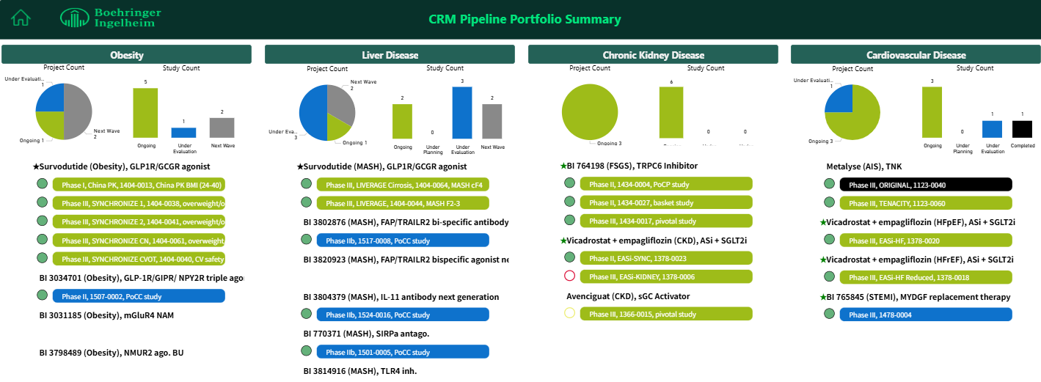
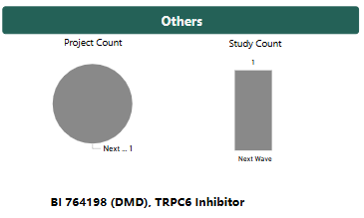
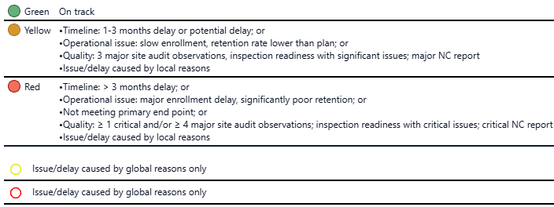


Slide 6
Topics
Pipeline Key Update
Decisions/Advice Provided by TA-CEC
TA Portfolio Key Update-Late Stage Assets
China Local Data Generation Key Update
TA Portfolio Key Update-Early Assets

Slide 7
Decisions/Advice provided by TA-CEC (CEC@2025.04.17) (1/3)
Topic | Background | TA-CEC Decisions/Advice | Next step/ Updates
Survodutide MASH+PEN registration strategy | The previous China NDA submission pathway was proposed, given the uncertainty of PEN package readiness and prioritizing the approval timeline of the two indications. Having MASH/PEN approval as early as possible, to maximize the convenience and benefits in the following MASH NRDL application and commercial activities. Having two indications (obesity and MASH) in one PEN with one license in the market is the ultimate goal for future goods. Based on the new request on MASH/PEN and the latest timeline of PEN package, the China NDA submission pathway is updated. | Endorsed. Other comments from CEC: Local Asset Lead confirmed that 1) new strategy will be shared to global supply for supply plan revisiting; 2) the timeline of obesity PEN and to have Obesity& MASH in one Pen/one license won’t affect the pricing negotiation for MASH PEN in NRDL; 3) PEN submission package is critical, if any delay, further evaluation on the submission strategy is needed. | New plan is fully aligned within local asset team, 2 indications in 1 pen won’t affect the pricing negotiation confirmed. New plan will be shared to global asset team for alignment via next ex-changing meeting of CN and global asset team. Any change of submission package development plan, further evaluation will be done within local asset team with necessary key stakeholders.

Slide 8


Recommended China NDA submission pathway
2026 |  |  |  | 2027 |  |  |  | 2028 |  |  |  | 2029 |  |  |  | 2030
Q1 | Q2 | Q3 | Q4 | Q1 | Q2 | Q3 | Q4 | Q1 | Q2 | Q3 | Q4 | Q1 | Q2 | Q3 | Q4 | Q1 | Q2 | Q3 | Q4
Global
US sub
Obesity
Nov
2026
US & EU sub
MASH
Oct
2027
EU sub
Obesity
Jun/Aug 2028
Global
China
The below submission pathway is recommended based on China Asset Team’s request and alignment.
CN sub
Obesity
Dec 2026
Obesity/AI
NDA review
15-18M
CN appr.
Obesity
Mar-Jun 2028
Obesity/PEN
review
12M*
CN appr.
Obesity/PEN
Mar-Jun 2029
China
China
CN sub
MASH
Nov 2027
MASH/PEN
NDA review
12M (PR)
CN con. appr.
MASH/PEN
Nov 2028
CN appr.
Obesity + MASH/PEN
Mar-Jun 2029
New proposal
12M approval timeline for post-approval change is set: leverage with MASH/Pen NDA application, apply to waive QC testing and accelerate Obesity/Pen review timeline.
A check point is set up in Oct 2028 to further evaluate Obesity/PEN post- approval timeline, due to evolvement of China regulation.
Reminder to consider the supply of AI and PEN.

Slide 9
Previous proposed China NDA submission pathway
2026 |  |  |  | 2027 |  |  |  | 2028 |  |  |  | 2029 |  |  |  | 2030
Q1 | Q2 | Q3 | Q4 | Q1 | Q2 | Q3 | Q4 | Q1 | Q2 | Q3 | Q4 | Q1 | Q2 | Q3 | Q4 | Q1 | Q2 | Q3 | Q4
Global
US sub
Obesity
Nov
2026
US & EU sub
MASH
Oct
2027
EU sub
Obesity
Jun/Aug 2028
Global
China
The following submission pathway was proposed previously：
Considering the uncertainty of PEN package readiness timepoint,
to ensure two indications approval as early as possible.
CN sub
Obesity
Dec
2026
Obesity/AI
NDA review
15*-18M
CN appr.
Obesity
Mar-Jun
2028
CN sub
MASH
Nov
2027
MASH/AI
NDA review
10M (PR)
CN con. appr.
MASH/AI
Sep
2028
MASH/PEN
Sub & review
12-18M
CN con. appr.
MASH/PEN
Q2, 2030
Original Plan

Slide 10

Current development status for Survodutide
From CMC perspective:
Formulations for AI & PEN will be different.
PFS is used in Phase 3 Obesity & MASH trials.
AI will be used for the initial Obesity NDA submission (in Dec. 2026).
PEN CMC Dossier will be ready by Oct 2027.
Sample for PEN registration QC-testing will be ready by Oct 2027¹.
PFS, Pre-filled Syringe; AI, auto injector (single dose pen); PEN, refers to multi-dose pen
1. The current plan will be consulted for HA’s opinion. Timeline will be further reevaluated based on HA’s feedback.
2. It is based on the current SRD design; the timeline will be further reevaluated based on HA’s feedback on design.
From Clinical perspective:
Obesity Ph3 CTR will be available in Oct. 2026.
MASH Ph3 CTR (conditional approval) will be available in Q3, 2027.
MASH Ph3 CTR (full approval) will be available in Q3 2029.
2 PK bridging studies are planned and under discussion
    PFS vs AI
    PFS vs PEN
PFS VS PEN PK bridging study report will be ready by Mar 2026².
The information above enable it possible to have MASH NDA submission with PEN.
*The assumption may be changed based on HA’s feedbacks on key issues on PK study design and QC-testing sample (expected Q3/Q4, 2025).

Slide 11
Assessment on the new proposed pathway
Indication | Submission Pathway |  | Approval time assumption |  | Trade/ Brand name | Assessment
 | Step 1 | Step 2 | For AI | For PEN
Obesity | Initial NDA with AI | Post approval change, switch AI to PEN | Best (15 M): Mar 2028 Base (18 M): Jun 2028 | Best (12 M*): Mar 2029 Base (12 M): Jun 2029 | Brand A | /
MASH (conditional approval) | Initial NDA with PEN | / | / | (priority review, 12M): Nov 2028 | /** | Earliest MASH/PEN approval
* Best and Base case is according to different submission timeline. 12M approval timeline for post-approval change is set: leverage with MASH/Pen NDA application, apply to waive QC testing and accelerate Obesity/Pen review timeline. A check point is set up in Oct 2028 to further evaluate Obesity/PEN post- approval timeline, due to evolvement of China regulation.
** Potential uncertainty to get trade/brand name “A” (Medium risk to have no brand but only Trademark for MASH/PEN.)
Assessment from commercial: Compared to the cost of losing chance of having MASH/PEN for NRDL negotiation in 2029, the impact of having no brand name but only trademark for MASH/PEN is controllable and tolerable.

Slide 12
Evaluation of different submission pathways
2026 |  |  |  | 2027 |  |  |  | 2028 |  |  |  | 2029 |  |  |  | 2030
Q1 | Q2 | Q3 | Q4 | Q1 | Q2 | Q3 | Q4 | Q1 | Q2 | Q3 | Q4 | Q1 | Q2 | Q3 | Q4 | Q1 | Q2 | Q3 | Q4
Global
US sub
Obesity
Nov
2026
US** & EU sub
MASH
Oct
2027
EU sub
Obesity
Jun/Aug 2028
Global
China
CN sub
Obesity
Dec
2026
Obesity/AI
NDA review
15-18M
CN appr.
Obesity
Mar-Jun 2028
Obesity/PEN
review
12M*
CN appr.
Obesity/PEN
Mar-Jun 2029
①
Earliest PEN approval (for MASH)
CN sub
MASH
Nov 2027
MASH/PEN
NDA review
12M (PR)
CN con. appr.
MASH/PEN
Nov 2028
China
YES
CN appr.
Obesity + MASH/PEN
Mar-Jun 2029
If PEN submission package could be ready by Oct. 2027?
②
Earliest MASH approval (for AI)
Same approval timeline for Obesity Pen and MASH Pen
CN sub
MASH
Nov 2027
MASH/AI
NDA review
10M (PR)
CN con. appr.
MASH/AI
Sep 2028
CN MASH full appr.
2030
NO
③
MASH approval timeline depends on PEN package availability
CN sub
MASH
tbc
MASH/PEN
NDA review
12M (PR)
CN con. appr.
MASH/PEN
tbc
Scenario 123
12M approval timeline for post-approval change is set for scenario 1: leverage with MASH/Pen NDA application, apply to waive QC testing and accelerate Obesity/Pen review timeline.
A check point is set up in Oct 2028 to further evaluate Obesity/PEN post- approval timeline, due to evolvement of China regulation.
Reminder to consider the supply of AI and PEN.

Slide 13
Registration information summary
INN
Survodutide Injection
Dosage form
Injection
Registration No. or license
Separate license for AI & Pen, one license for each strength (规格)

Slide 14
Decisions/Advice provided by TA-CEC (CEC@2025.05.12) (2/3)
Topic | Background | TA-CEC Decisions/Advice | Next step/ Updates
ORIENTAL trial timeline update | The previous timeline (eg: FPI Jul 2025) was based on Metalyse's BLA in Jan 2025. Revised timeline of FPI (to Dec 2025 ) is based on updated BLA-approval (May 2025) and commercial launch (Sep.2025) timeline One-month extended enrollment period is based on PI's consideration of time needed for Metalyse hospital listing at sites. | CEC decision: endorsed the new timeline | /

Slide 15
Decisions/Advice provided by TA-CEC (CEC@2025.05.12) (3/3)
Topic | Background | TA-CEC Advice | Next step/ Updates
BI 764198 (TRPC6i) Ph III trial in pFSGS (1434-0017) China Leading PI selection | Evidence Team proposed to select Prof. Xueqing Yu (余学清) as the China Leading PI of the Ph III trial based on the following considerations: Great domestic and international influence in the field with important positions in various associations (e.g. President of APSN) and as the Dean of Guangdong Provincial People's Hospital Extensive clinical and research experience in the field,China Leading PI in over 20 clinical trials including many MRCTs. China Leading PI of TRPC6i Ph II trial (1434-0004) and contributed 4/8 patients enrolled from China. He and his team have accumulated deep understanding and rich experience with the study compound. The site has MSA with Boehringer and demonstrated fast start-up in the past trial (4.8 months from CTA submission to SIV). | CEC agreed with the proposal Suggested team to explore the feasibility of including Prof. Yu in the Steering Committee (SC) of the trial. | To visit Prof. Yu to communicate about the study and check his interest and feasibility. To check with corporate team about the SC setup status and the selection criteria of SC members before visiting Prof. Yu

Slide 16
Topics
Pipeline Key Update
Decisions/Advice Provided by TA-CEC
TA Portfolio Key Update-Late Stage Assets
China Local Data Generation Key Update
TA Portfolio Key Update-Early Assets

Slide 17
TA Portfolio Key Update-Late Stage Assets
Asset Name (MoA) | Indication | China Approval (base case) | Update (please include key achievements, issues/risks, and etc.) | Next Step
Survodutide (GCGR/GLP-1R dual agonist) | Obesity | Jun, 2028 | Virtual SYNCHRONIZE™ -CVOT PaReS 2025 Annual meeting was held on Apr. 24th, 2025. HAI for PEN Development strategy (CMC properties, PK bridging study design) will be submitted on May 23th.
 | MASH (F2-F3) conditional approval | Nov, 2028 | Till Apr. 30th, the site activation and patient recruitment for the program in China is on track (LIEVERAGE:14 sites activated, 12 pts screened, LIVERAGE-Cirrhosis:13 sites activated. 7 pts screened) LIVERAGE Internal Workshop for a focus group discussion around the program uptake and potential collaboration between global, CN/JP countries teams and PXL is planned on Jun 2nd. | Information exchange with global and PXL, keeping monitoring the program status in China
 | MASH (F2-cF4) full approval | Oct, 2030
One HP Priority
TA Priority

Slide 18
TA Portfolio Key Update-Late Stage Assets (2/3)
Asset Name (MoA) | Indication | China Approval (base case) | Update (please include key achievements, issues/risks, and etc.) | Next Step
Vica+Empa (aldosterone synthase inhibitor + SGLT2 inhibitor) | CKD | Mar, 2030 | EASi-KIDNEY trail start-up delayed continuously, global evidence Lead will be meeting with Oxford to discuss in the next few weeks. Meeting with national coordinator of EASi-SYNC – Prof. Fangfang Hou at investigator meeting on 19th Jul. | Further evaluation with Oxford is anticipated in Jun
 | HFpEF | Nov, 2029 | 118 (vs. 45 planned) patients randomized in China, while global recruitment keeps in same momentum (1,334 vs. 1,202 planned)
 | HFrEF | Sep, 2030 | N.A.
 | CVRR | Oct, 2031 | FDA meeting canceled after initial positive feedback, final protocol archived on 5th May Meeting with National Coordinator-Prof. Yida Tang is scheduled on 5th Jun.
One HP Priority
TA Priority

Slide 19
TA Portfolio Key Update-Late Stage Assets
Asset Name (MoA) | Indication | China Approval (base case) | Update (please include key achievements, issues/risks, and etc.) | Next Step
Metalyse (TNK) | AIS <4.5h | May, 2025 | BLA review at NMPA has been completed on May 14th . The License is under preparation at NMPA and expected to receive soon. Current approval timeline assessment: high possibility to receive BLA approval in mid-May. | Follow up NMPA review and approval process. Further accelerate Gentamicin IPC method switch to ensure smooth launch.
 | AIS Late Window | Q2, 2029 | CDE written feedback (Stat, CP, Clinical) received in Apr; clarification question on dosing scheme to CDE CP is still open. EMA final written feedback received in May; Key considerations on study design based on feedback from HAs: (1) Time window: to further discuss at this MAP (2) Dosing scheme; (3) Double – blind design; Steer committee meeting will be held during ESOC; Competitor Mingfule-CSPC late time window (4.5-24h) registration trial obtained the CTA permission in Apr 2024 | Global and local team will jointly discuss CDE & EMA feedback to reach an alignment on study design.
One HP Priority
TA Priority

Slide 20
Topics
Pipeline Key Update
Decisions/Advice Provided by TA-CEC
TA Portfolio Key Update-Late Stage Assets
China Local Data Generation Key Update
TA Portfolio Key Update-Early Assets

Slide 21
TA Review Meeting
Mature Product Overview Metabolism
Product | ·Indication | Study type/Global Status (Study no.: FPI-LPO, CTR) | China Dev. Strat. | Current status | Next Mile-stone | Key Updates
Jardiance (Empagliflozin) | HFrEF | China local NISed (1245.0291:Nov 2021-Q1 2026) | China alone | IEC approval | Feasibility analysis 1 (2024 Q1) | Current database enrolment delay: due to VBP, and drug switch situation HAI was sent on Jan 20th, waiting for CDE’s feedback CDE feedback on 14 May: Suggest submitting the periodical analytical report of the above two post-approval clinical trials, if any serious safety issue identified, should submit the relevant report in time. Team will ha ve the internal disucssion on 15 May
Jardiance (Empagliflozin) | HFpEF | China local NISed (1245.0313:Q4 2022-Q1 2026) | China alone | IEC approval | Feasibility analysis 1 (2024 Q1)
问询CDE的问题：CDE是否同意BI延期至下一次再注册申请时（计划于2031年）提交完整的上市后临床研究报告？
CDE feedback received at 14 May:
建议两项上市后临床研究过程中适时提交阶段性分析报告，如有严重安全性问等，应及时提交报告。

Slide 22
TA Review Meeting
Mature Product Overview Metabolism
Product | ·Indication | Study type/Global Status (Study no.: FPI-LPO, CTR) | China Dev. Strat. | Current status | Next Mile-stone | Key Updates
Survodutide | Obesity BMI cutoff definitions among China and Japan | China local NISed (1404.0072:Q4 2024-Q3 2026) | China alone | EC Approval | Data analysis (2025 Dec) | Contract: 1) Binhai(signed on Dec 13th) and 2)PKU(signed on Apr 2nd) PKU EC approval was on Mar 12th, and Binhai EC approval was on Mar 6th Waiting for PKU and Yinzhou’s agreement sign-off then data analysis Kick-off meeting might combine with anniversary celebration, waiting for more details from Dr.Li
Survodutide | Obesity+MASLD | China local NISed (1404.0073:Q4 2024-Q2 2026) | China alone | EC Approval | Data analysis (2025 Nov) | Under data analysis Kick-off meeting might combine with anniversary celebration, waiting for more details from Dr.Li

Slide 23
TA Review Meeting - Lytics
Product | ·Indication | Study type/Global Status (Study no.: FPI-LPO, CTR) | China Dev. Strat. | Current status | Next Mile-stone | Key Updates
Metalyse (ORIENTAL study) | Acute ischaemic stroke | ECR (1123-0064; Jul2025-Mar2028; Sep2028) | China alone | Global proposal approval | Global protocol approval (Feb2025) | Proposal global approval completed on 31Mar. Kickoff meeting completed 9May Protocol and contract under development. CEC endorsed the updated timeline. IM in July under preparation
Metalyse (Metalyse in late time window (4.5h-24h) with the guidance of NCCT) (Huashan hospital) | Acute ischaemic stroke | IIS (TBD) | China alone | Lectrona submission | CEC approval (TBD) | Study design/budget/timeline under evaluation Waiting for CEC approval
Metalyse (Metalyse for LVO-AIS at 4.5-24h without thrombectomy under the guidance of NCCT) (Anhui Provincial hospital) | Acute ischaemic stroke | IIS (TBD) | China alone | CEC approval | Proposal approval | Ad-hoc CEC endorsed on 15Apr. Proposal need further modify.
Metalyse (Metalyse before interhospital transfer for thrombectomy in large vessel occlusion at 4.5 to 24 hours (TREASURE)) (Xuanwu Hospital) | Acute ischaemic stroke | IIS (TBD) | China alone | CEC approval | Proposal approval | Ad-hoc CEC endorsed on 15Apr. Proposal need further modify.
Metalyse (Intra-arterial thrombolysis with Metalyse in MeVo (medium vessel occlusions) (Tiantan hospital Prof. Liu) | Acute ischaemic stroke | IIS (TBD) | China alone | CEC approval | Proposal approval | Ad-hoc CEC endorsed on 15Apr. Proposal need further modify
Metalyse (Real world effectiveness and safety of thrombolysis with Metalyse in different level of stroke centers in Shandong Province) (Qilu Hospital) | Acute ischaemic stroke | IIS (TBD) | China alone | Proposal under discussion | Lectrona submission and CEC approval (TBD) | Study design/budget/timeline under evaluation Waiting for lectrona submission and CEC approval
Actylise | Acute ischaemic stroke | ECR (0135-0353: Sep 2024- Sep 2026) | China alone | Protocol approve (Apr2025) | Contract (Oct2025) | CEC endorsed on 19Sep 2024 Hybrid review completed on 22nd Jan. proposal released on 14th Feb. Protocol completed on 26Mar, one month ahead timeline Contract comments review by legal

Slide 24
Topics
Pipeline Key Update
Decisions/Advice Provided by TA-CEC
TA Portfolio Key Update-Late Stage Assets
China Local Data Generation Key Update
TA Portfolio Key Update-Early Assets

Slide 25
Avenciguat in GN Ph III (1366-0015) timeline likely to shift due to delayed RoFD
522 days
174 days
218 days
261 days
217 days
438 days
68 days
66 days
2025
2025
2026
2027
2028
2029
2030
2031
2031
Today
Jul 2
final CTP
Oct 20 - Oct 20
global FSS to LSS
Global
Nov 3
interim analysis
Feb 22 - Oct 23
US AA sub - app
May 1 - Mar 1
US FA sub - app
Jan 26 - Apr 30
EoPh II sub - feedback
Aug 15 - Nov 14
CTA sub - app
China
Feb 13 - Oct 20
fSIV - LSS
Mar 22 - Mar 22
China AA sub - app
Jun 1 - Apr 1
China FA sub - app

Slide 26
TA Portfolio Key Update- Avenciguat
Asset Name-MoA | Indication | China Approval (base case) | Update | Next Step
Avenciguat (sGC activator) | CKD-IgAN/GN | Sep 2029 (conditional approval); Jun 2031 (full approval) | HPSC didn’t endorse RoFD in Apr and requested the team to come back in Jun with de-risking activities. Different scenarios of adding futility analysis and implications on project timeline and budget are under discussion. As the consequence: 1) Ph III trial preparation is currently on hold 2) no impact on EoPh II HAI 3) IAP release after RoFD endorsement; China ICP expected if best case launch still within 2029 | To closely monitor global status To resume Ph III preparation activities (e.g. selection of leading PI and study sites) upon RoFD release
 |  |  | EoP2 clinical queries were received on 29 Apr. Team targets to respond by mid next week though no timeline was specified by the reviewer. Global team prefers CDE feedback before HPSC in Jun (meeting date TBD). Queries from non-clinical, CMC, Stats are pending. Unlikely to have a virtual meeting if queries could be clearly addressed through written response. | To prepare the response to clinical queries To monitor CDE review status of other departments

Slide 27
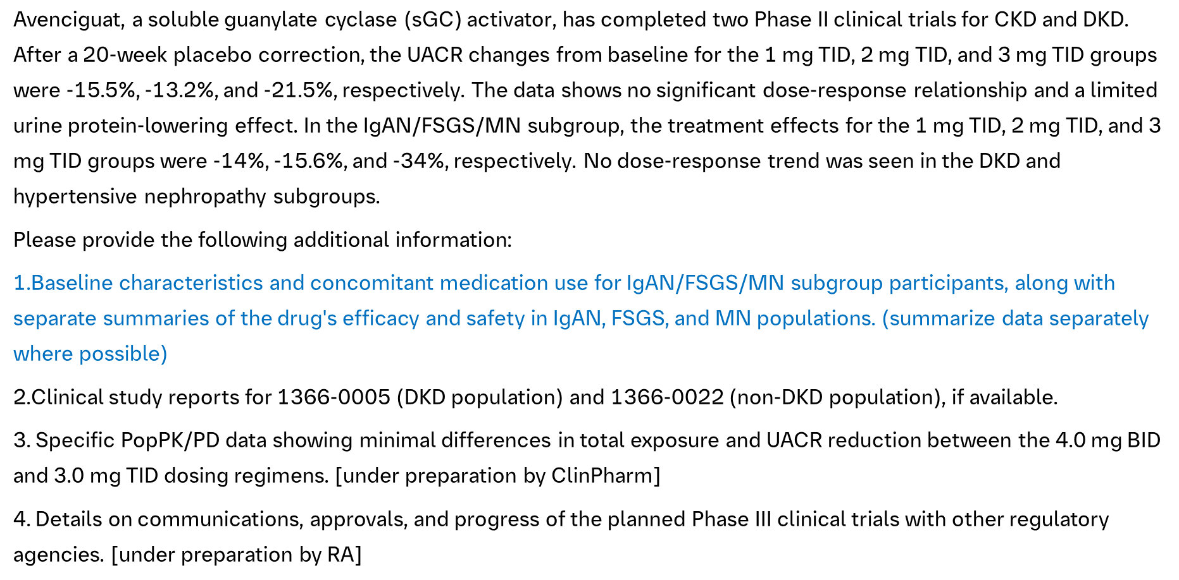
Avenciguat updates — EoP2 clinical queries received
Interpretation of the request:
To provide further evidence to show the robustness of Ph II efficacy and safety results in IgAN/FSGS/MN population
To provide further evidence to justify why the Ph II results could support such Ph III design for the proposed label, to fill the potential gaps (e.g. dose, population, endpoints etc.)

Slide 28
Avenciguat (sGC act.) in GN Ph III (1366-0015) trial design
Avenciguat 4 mg twice daily on top of SoC (n≈550)
Follow-up Period
Screening Period
1:1
Matching Placebo twice daily on top of SoC (n≈550)
Up to 8 weeks
At least 24 months
4 weeks
Screening
Randomization
End of treatment
End of study
Month 9 – Interim Analysis IgAN
Primary Endpoint (ΔUPCR)
for accelerated approval
(n≈300)
Final Analysis
Primary Endpoint (eGFR slope) for full approval
(n≈1,100)
Individually powered for primary endpoint (n≈500)
→ To be included in testing hierarchy
IgAN
Primary Endpoint for accelerated approval:
Change in proteinuria (UPCR based on first morning void) from randomization to month 9
Primary Endpoint for full approval:
total annualized eGFR slope from baseline to end of treatment (at least 24 months)
Key Inclusion criteria
≥12 years and 40 kg
eGFR ≥20 ml/min/1.73m2
UPCR >750 mg/g
Biopsy proven GN
On optimized/maximally tolerated RAASi, SGLT2i, MRA and ERA for ≥8 weeks
oral immunosuppressives on stable dose for ≥3 months
Key Exclusion criteria
rapid progressive kidney disease as measured by eGFR loss ≥ 50% over a period of 3 months prior to Screening
History of kidney transplant or planned kidney transplant
Systolic blood pressure <100 mmHg
i.v. immunosuppressive treatment ≤6 months

Slide 29
TRPC6 in FSGS Ph III (1434-0017) timeline
659 days
567 days
261 days
262 days
65 days
65 days
2025
2030
2025
2026
2027
2028
2029
2030
Today
final CTA package
Global
Sep 4
Dec 3 - Jun 13
global FSS - LSS
Sep 4 - Sep 4
US NDA sub - app
Apr 9 - Jul 9
EoPhII submission - feedback
Oct 10 - Jan 10
CTA sub-app
China
Apr 10 - Jun 13
fSIV - LSS
Oct 4 - Oct 4
NDA sub - app (best)

Slide 30
TA Portfolio Key Update- BI 764198 (TRPC6i)
Asset Name-MoA | Indication | China Approval （base case) | Update | Next Step
BI 764198 (TRPC6 inhibitor) | CKD-pFSGS | Apr 2031 | HPSC endorsed PoCP release and all planned development activities for pFSGS, podocytopathies and DMD indications. China EoPh II submission on 09 Apr with CDE feedback expected in early Jul China leading PI proposal aligned between TA Medicine and CD&O China country feasibility completed and feedback provided to global team BTD application under planning, likely after EoPh II FDA feedback in early Jun | To prepare for the Ph III study To monitor EoPh II feedback from other HAs and proactively prepare for a potential meeting with CDE
 | podocytopathies | TBD | China pre-IND preparation kicked off with target submission on 20 Jun No China specific question so far, mainly to consult about the basket design and development strategy | To prepare for the pre-IND submission
 | DMD | Feb 2034 | Global consultation meeting with Prof. Dai, Yi from Peking Union Hospital occurred on 12 May with positive feedback from corporate team. | To monitor the global development planning and discuss about China integration strategy.
One HP Priority
TA Priority

Slide 31
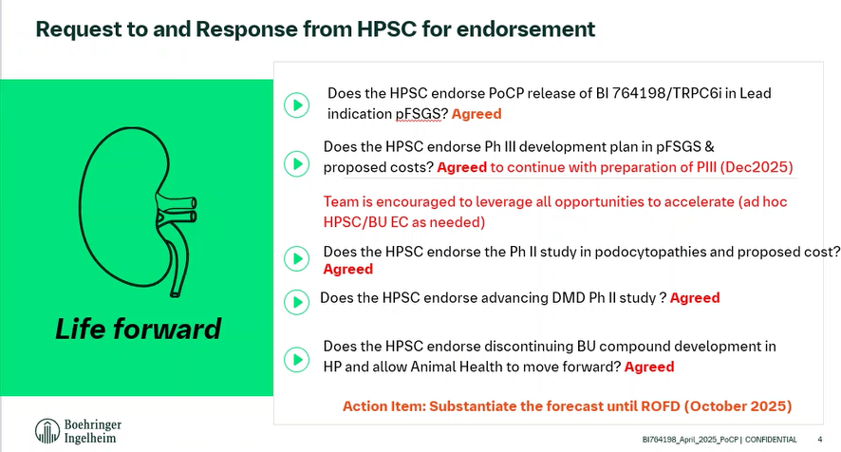

Slide 32
Asset vision: TRPC6i is the 1st line targeted non-immunosuppressive treatment of choice transforming lives for patients with podocytopathies to prevent ESKD
sFSGS
pFSGS
Sentinel
AS
TR-MCD
TR-MN
FSGS – Focal Segmental Glomerulosclerosis
TR- MCD – Tx resistant Minimal Change Disease
TR-MN – Tx resistant Membranous nephropathy
AS – Alport Syndrome

Slide 33
Asset value maximization
TRPC6i has therapeutic potential in multiple pathologies
PII (PoCP) pFSGS
Oral, QD
IV
Kidney
Prevent loss of podocytes
Muscle
Prevent loss of muscle function
Septic shock
Prevent loss of end-organ damage
Aurobac
PIII
pFSGS
PII
Basket study podocytopathies
PII/III
DMD
PII
Septic shock
Ni SOD 2023
Ni SOD 2023
PIII
Select indications
PIII
Septic shock

Slide 34
BI 764198 (TRPC6i) in FSGS Ph III (1434-0017) trial design
Draft
BI764198 20 mg once daily on top of SoC* (n≈113)
BI764198 20 mg once daily
Screening Period
1:1
Follow-up
Period
Matching Placebo once daily on top of SoC* (n≈113)
Up to 4 weeks
52 weeks
52 weeks
4 weeks
Screening
Randomization
End of randomized treatment period
End of treatment
End of study
Final Analysis for
Full Approval
Change in proteinuria (UPCR) vs. Placebo BL → week 52
Key Inclusion criteria
≥12 years and 40 kg
eGFR ≥25 ml/min/1.73m²
UPCR >1,500 mg/g
Diagnosis of
  Biopsy-proven primary FSGS OR
  FSGS related to a mutation in the TRPC6 gene
On optimized/maximally tolerated RAASi, SGLT2i, MRA for ≥8 weeks prior to screening
oral immunosuppressives on stable dose for ≥3 months prior to screening
Key Exclusion criteria
rapid progressive kidney disease as measured by eGFR loss ≥ 50% over a period of 3 months prior to Screening
History of kidney transplant or planned kidney transplant
i.v. immunosuppressive treatment ≤6 months
BMI >40 kg/m2 (for ≥18 yrs) or <5th and >99th percentile for age and sex (participants <18)
Primary Endpoint
Change in proteinuria (UPCR based on 24h-urine collection) from randomization to week 52
Key Secondary Endpoint
% of patients with UPCR <1.0 g/g at week 52
* Defined as RAASi&SGLT2i use if indicated and tolerated as well as immunosuppressive treatment

Slide 35
BI 764198 (TRPC6i) in podocytopathies Ph II (1434-0027) trial design
Preliminary draft
sFSGS
Histopathological similarity
UPCR > 750 mg/g
BI 764198 (n≈14)
Placebo (n≈7)
TR-MCD
Disease continuum
UPCR > 1.0 g/g
BI 764198 (n≈14)
Primary endpoint
%-change in proteinuria
Responder analysis (defined by UPCR reduction threshold, e.g. 25%)
Placebo (n≈7)
Screening
Alport Syndrome
Podocyte involvement
UPCR > 500 mg/g
BI 764198 (n≈14)
2:1
R
Placebo (n≈7)
Steroid-naïve MCD
Disease continuum
UPCR > 1.0 g/g
BI 764198 on top steroids (n≈14)
Placebo on top of steroids (n≈7)
TR-MN
TRPC6 dysregulation
UPCR > 1.0 g/g
BI 764198 (n≈14)
Placebo (n≈7)
20 weeks
Inclusion Criteria
Age ≥18 (≥12 for Alport Cohort outside EMA)
Biopsy proven disease (genetic diagnosis in Alport sufficient)
eGFR ≥25 ml/min/1.73m2
Optimized and stable SoC, including RAASi, SGLT2i and immunosuppressives (if indicated)
Exclusion Criteria
rapid progressive kidney disease as measured by eGFR loss ≥ 50% over a period of 3 months prior to Screening
History of kidney transplant or planned kidney transplant
i.v. immunosuppressive treatment ≤6 months
Note: FSGS, focal segmental glomerulosclerosis; IA, interim analysis; MN, membranous nephropathy; sFSGS, secondary FSGS; R, randomization;
TR-MCD: treatment-resistant minimal change disease; TRPC6, transient receptor potential canonical 6.
CONFIDENTIAL
35

Slide 36
Study outline Phase II – 1434-0019
48 weeks
24 weeks
BI 764198 (n=20)
Dose corresponds to 40mg in adults
LTE open-label
BI 764198
S
R
Placebo (n=20)
on top of background therapy
Study Design | Randomized (1:1), placebo controlled, phase II, global sites (approx 40-50) |  | LTE for patients in active treatment, Option 2: switch placebo pat to open label treatment | LTE for patients in active treatment, Switch placebo pat to open label treatment
Patients | N=40 (N=20 BI 764198 vs. N=20 Placebo) |  | N= 40on BI 764198 | N= 40on BI 764198
Target Population | Duchenne Muscular Dystrophy (DMD)
Inclusion Criteria | Males aged 5 to <11y, confirmed DMD defined by immunoflourescence an/or immunoblot showing dystrophin deficiency OR confirmed mutation within the DMD gene (deletion/duplication of one or more exons) OR dystrophin gene sequnecing showing alteration that is expected to preclude dystrophin protein production Supine to Stand Time in ≥ 5 and <10 seconds North Star Assessment 18-25 seconds
Exclusion Criteria | Initiation of glucocorticoid therapy < 6 month prior to screening Exposure to any dystrophin restoration product (gene- or exon skipping therapy) Left ventricular ejection fraction (LVEF) <55% or Evidence of symptomatic cardiomyopathy Use of any pharmacologic treatment, other than corticosteroids, that might have had an effect on muscle strength or function within 3 months prior to the start of study treatment (e.g., growth hormone)
Primary outcome | Efficacy endpoint is mean change from baseline to week 48 for STS (velocity) vs. Placebo |  | Further change from baseline to week 24 LTE for STS (confirmatory)
Secondary outcome | Safety (TEAE, SAE, AESI) North Star Ambulatroy Assessment (NSAA), 6-minute walk test (6MWT), 4-stair climb Stride velocity (SV95C) QoL, patient reported outcomes Lung function parameters
Biomarker readouts | Echocardiography (LVEF) MRI for fat content (TBD)
Waiver | TBD

Slide 37
Thank you!

Slide 38
TA Portfolio Key Update- BI 3034701 (GGY2Ra.)
Asset Name-MoA | Indication | China Approval (base case) | Update | Next Step
BI 3034701 (GGY2Ra.) | obesity | Jul 2033 | gPh I SRD/MRD readout available in Q3/Q4 2025, slightly postponed to add additional dose cohorts as exposure is lower than predicted PoCP based on MRD timeline remains unchanged in Dec 2025 whether to skip gPh II pre-IND with FDA/EMA under discussion value maximizaiton in other indications under discussion China sub-team made preliminary evaluation of benefits and risks of skipping pre-IND, and planned re-evaluation in end May after JP team’s meeting with PMDA to discuss about PK strategy | To monitor global development progress and decision on pre-IND To monitor JP PK strategy based on PMDA’s feedback To re-evaluate pre-IND skipping based on the above information
One HP Priority
TA Priority

Slide 39
BI 3034701 (GGY2Ra.) in obesity timeline draft
108 days
60 days
64 days
59 days
66 days
2025
2025
2026
Today
Aug
Oct
Dec
Feb
Apr
Jun
Aug
Oct
2026
Ph I SRD readout (TBC)
Aug 29
Ph I MRD readout (TBC)
Nov 14
Global
Ph II draft TDO
Oct 6
Ph II CTA package release
Feb 13
Jun 22 - Nov 19
Ph II FSS - LSR
on critical path!
Dec 12 - Mar 6
Plan A: HAI based on MRD data
China
Sep 26 - Dec 26
Plan B: HAI based on SRD data
Feb 28 - May 28
Ph II CTA sub - app
Aug 28 - Nov 19
China fSIV - LSR

Slide 40
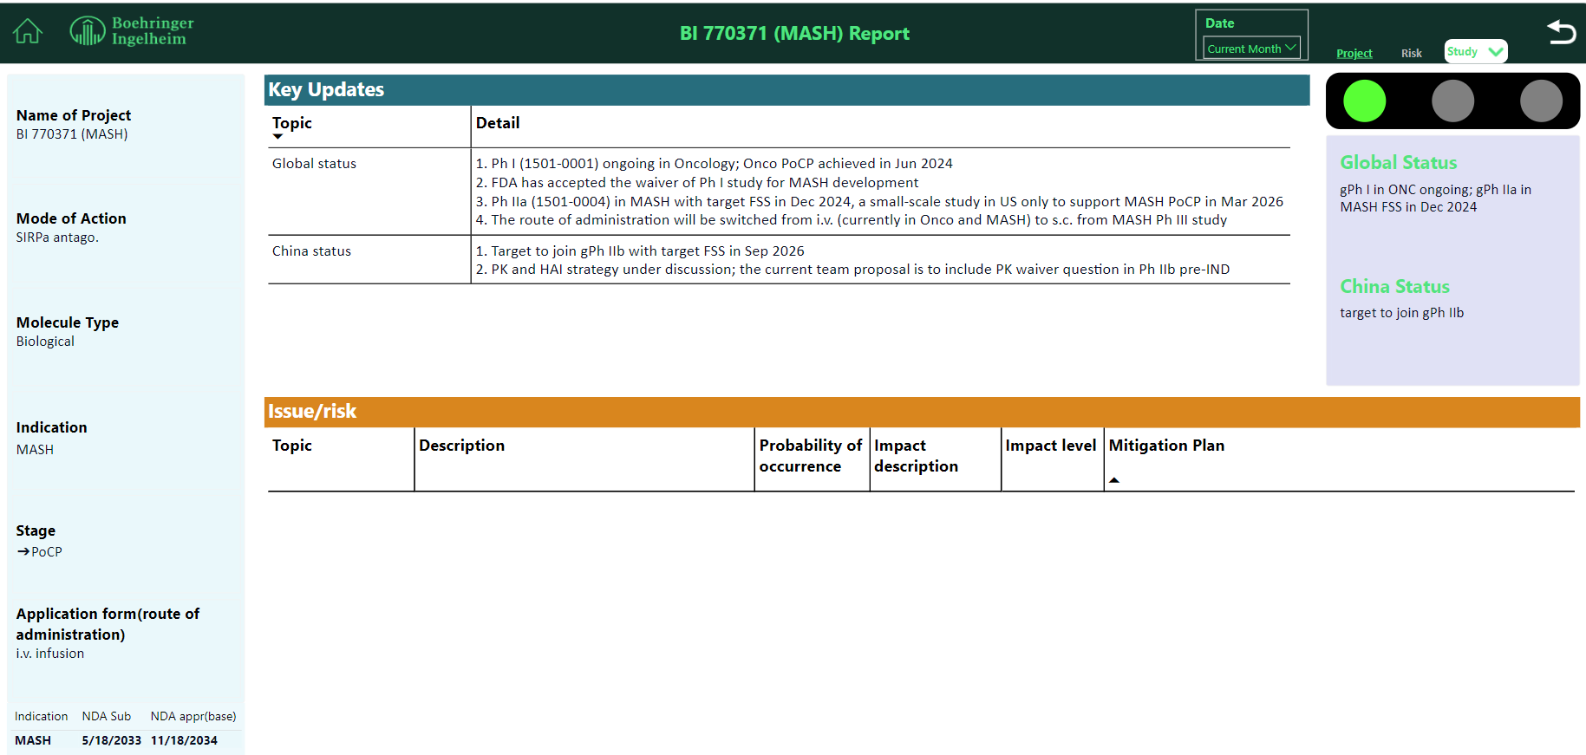

Slide 41
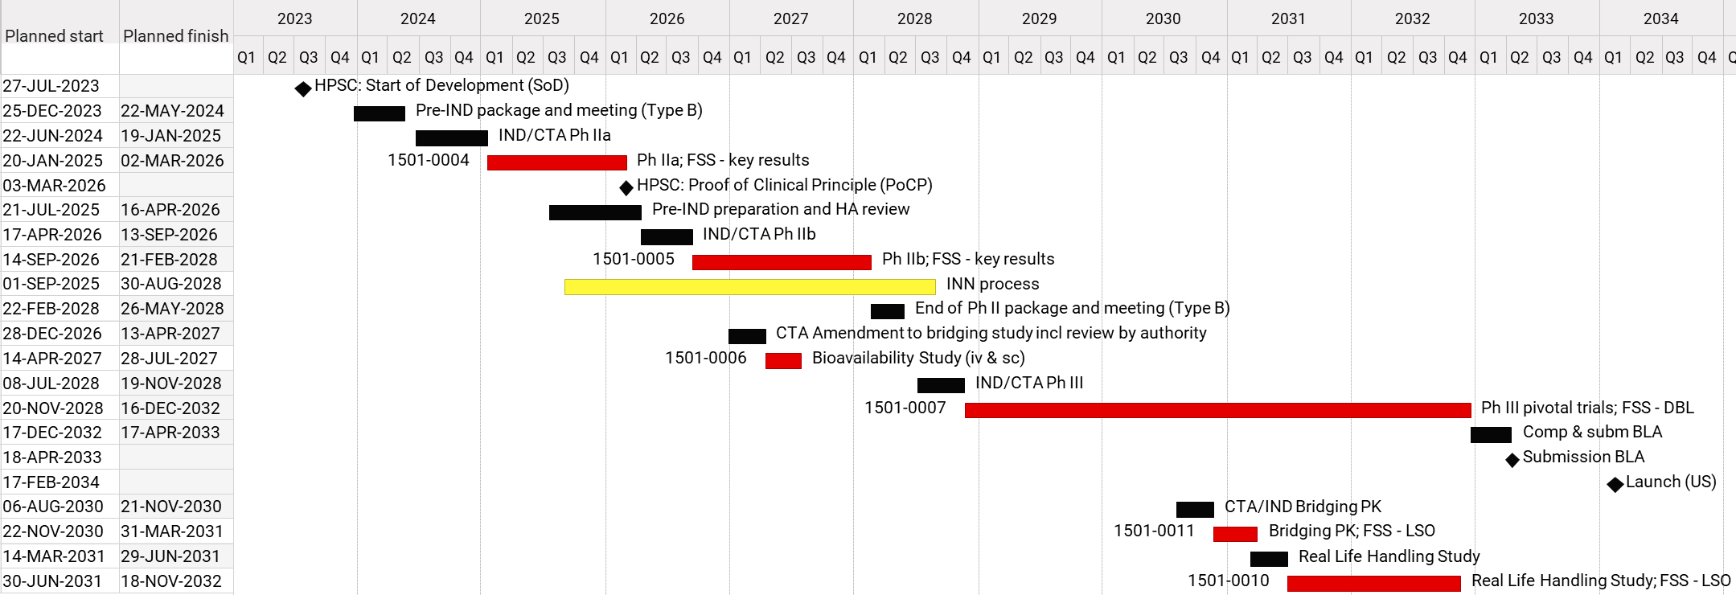
BI 770371 (MASH) – Clinical Timeline high level
V3
confidential, do not distribute

Slide 42
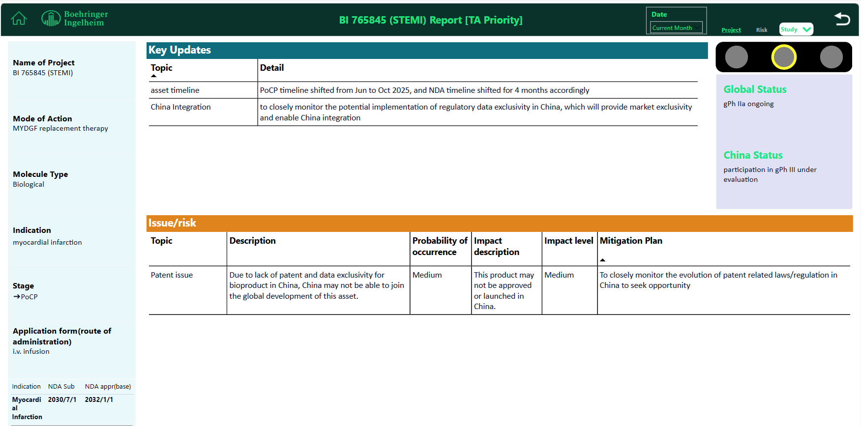

Slide 43
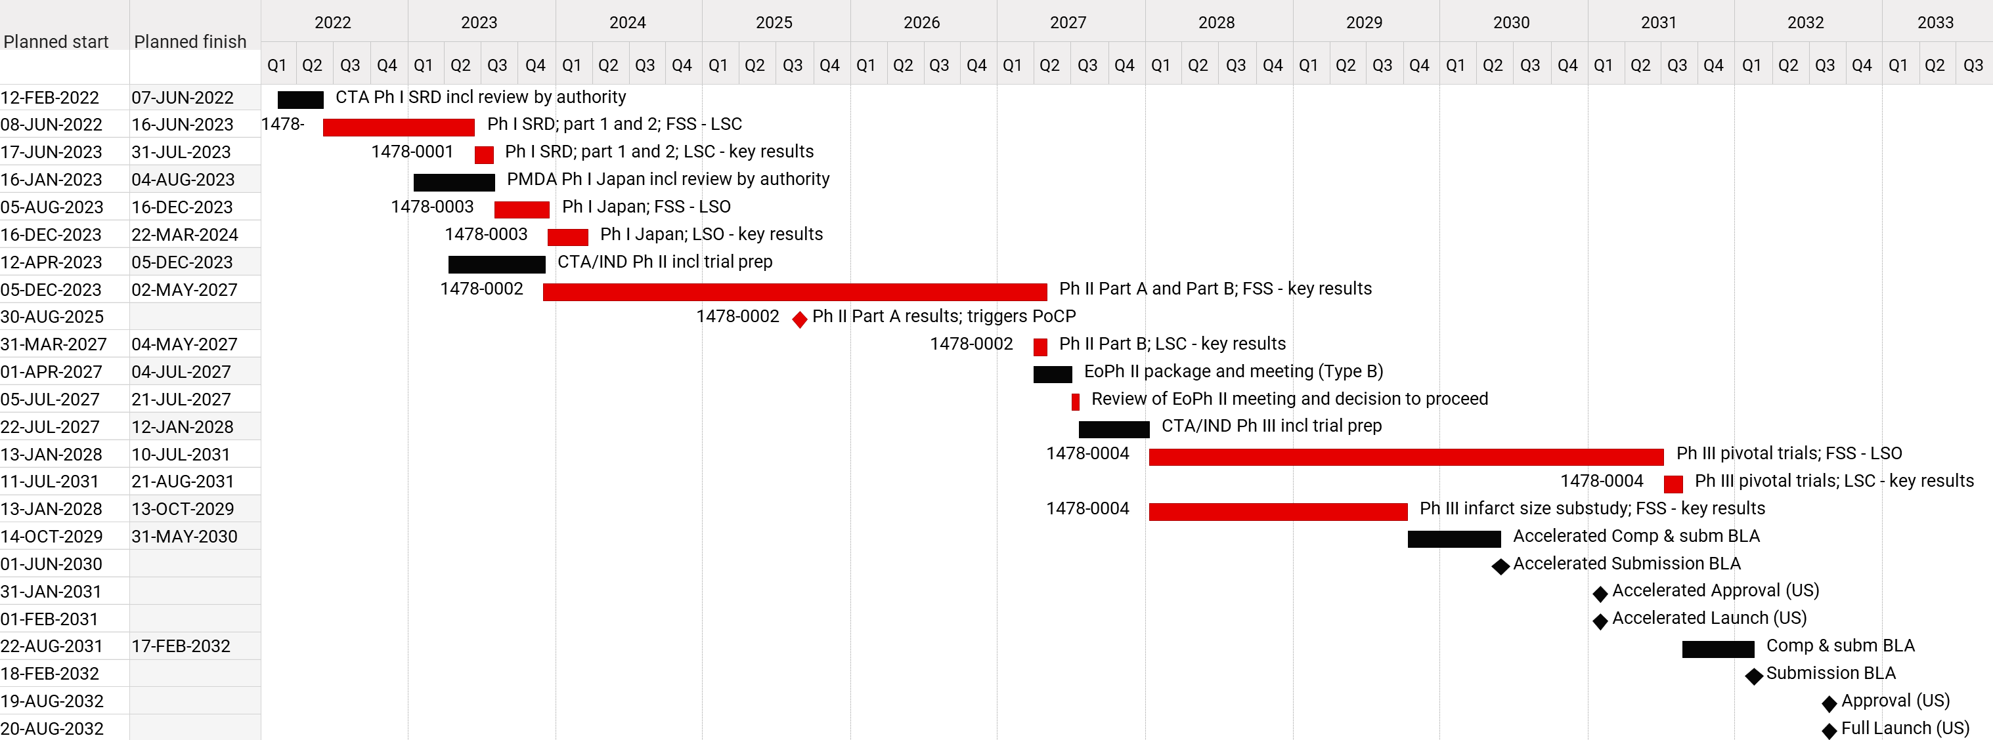
BI 765845 – high level clinical & regulatory timelines
V7
confidential, do not distribute

Slide 44
TA Key Update (for non-portfolio)

